Slide 1
Introduction to CyberGIS
Dr. Junjun Yin
CyberGIS Center for Advanced Digital and Spatial Studies
Department of Geography and Geographic Information Science
National Center for Supercomputing Applications
University of Illinois at Urbana-Champaign, IL, 61801, USA
January 19, 2016

Slide 2
GEOG 479: Advanced Topics in GIS – CyberGIS
Course Goals
Be familiar with the high-performance computing components in CyberGIS
Leverage the CyberGIS architecture and resources to facilitate spatial thinking and knowledge discovery from geospatial Big Data.
Interact with geospatial Big Data in various forms (e.g., geo-located Twitter data, Taxi trajectory data and national DEM, etc.)
Solve geospatial problems with high-performance computing approaches.
Course Syllabus
https://bitbucket.org/geog479/course/downloads/Syllabus.pdf
Course materials
https://bitbucket.org/geog479/

Slide 3
GEOG 479: Advanced Topics in GIS – CyberGIS
Course Outline
Introduction to CyberGIS, Geospatial Big Data and ROGER
High performance computing, cyberinfrastructure and GIS
Getting started with ROGER
Distributed Spatial Databases
Taming Big Geospatial Data with Hadoop
Advanced Geospatial Data Analytics
Mid-term project
Terrain analysis: Parallel MapAlgebra for Spatial Analysis
Interactive Geo-visualization of Large-scale Movement Data with Spark
Final project

Slide 4
What is CyberGIS?
Cyber + GIS ?

Slide 5
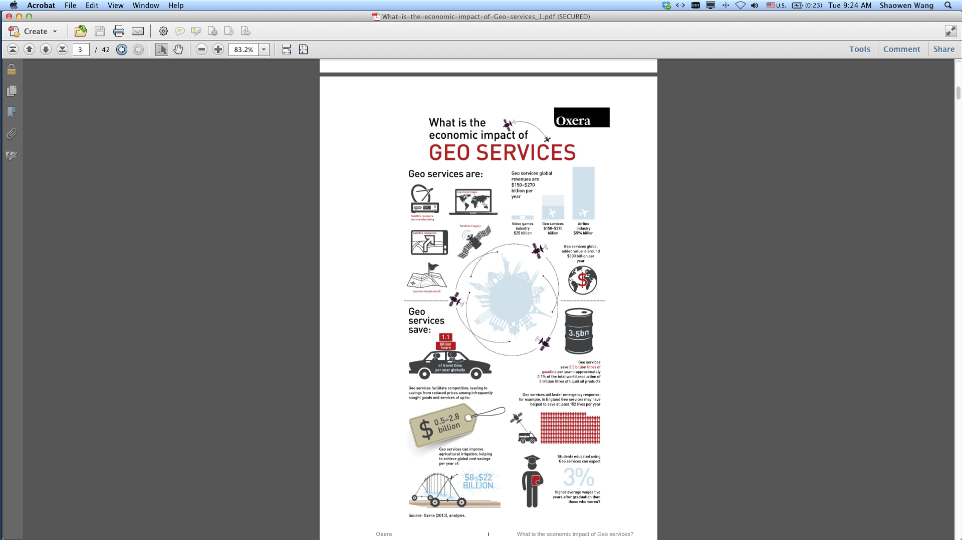
What is GIS?
Systems
Science
Services
Society
Synthesis
Spatial is special
Image source: http://www.oxera.com/Oxera/media/Oxera/downloads/reports/What-is-the-economic-impact-of-Geo-services_1.pdf
Notes:
Left side: many components of GIS. It’s data, computer networks, academics and professionals… spatial data has special concerns that other kinds of data like tables don’t have. Need to decide how to represent it, determine if data values are spatially dependent/autocorrelated, locations are often sensitive in terms of privacy…
Right: a report on impact of geospatial services. Nearly every major company is employing spatial decision making, and everyday people are making on-the-fly spatial decisions enabled by maps and apps on their smartphones.

Slide 6

What is CyberGIS?
CyberGIS is the synthesis of cyberinfrastructure, GIS and spatial analysis
Why CyberGIS?
Geospatial discovery and innovation with advanced digital technologies¹
Big data
Big compute
CyberGIS
Big collaboration
Big problems
1. Wang, S. (2013)
Notes:
CyberGIS more focuses on Spatial thinking.
These advanced technologies not only bring forth computational
innovation such as geospatial optimization and simulation, but also
yield actionable insight from big data. GIScience therefore seeks today to resolve
problems of dealing with and analyzing heterogeneous spatial data, integrating
and synthesizing diverse data sources, and orchestrating collaboration, rather
than data collection and pre-processing.

Slide 7
cyberinfrastructure
CyberGIS is Geographic Information Science and Systems based on advanced cyberinfrastructure.
Cyberinfrastructure includes:
(high performance) computing systems
data storage systems
advanced instruments
data repositories
visualization environments
people
linked by high speed networks
Notes:
CyberGIS is Geographic information science and systems based on advanced cyberinfrastructure

Slide 8


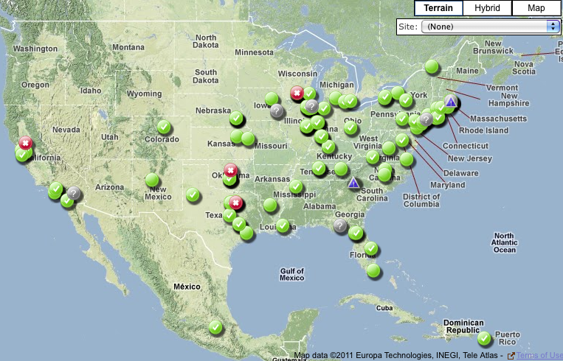
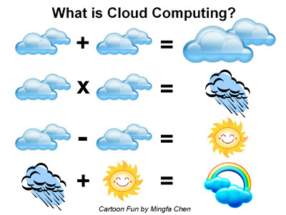
Advanced Digital and Spatial Studies
CyberGIS Toolkit
CyberGIS Gateway
GISolve Middleware
www.ncsa.illinois.edu/BlueWaters/
www.opensciencegrid.org
www.xsede.org
http://lakjeewa.blogspot.com/2011/09/what-is-cloud-computing.html
Notes:
Recommend to take a detailed look at these resources
Three pillar CyberGIS artichteture
The main part of this is the three parts of the software stack:
1 – Toolkit: actual processing code that runs on clusters. Open source.
2 – Middleware: tracks and assigns jobs on diverse kinds of computing resources. GIS programmers don’t have to know the particularities of one system vs. another; the middleware takes care of that.
3 – Gateway: easy to use web interface for building CyberGIS jobs, which hands them off to the middleware.

Slide 9
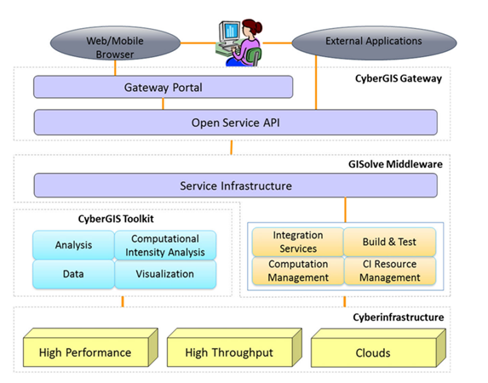
CyberGIS Software Environment
CyberGIS
Gateway
CyberGIS
Toolkit
GISolve
Middleware

Slide 10
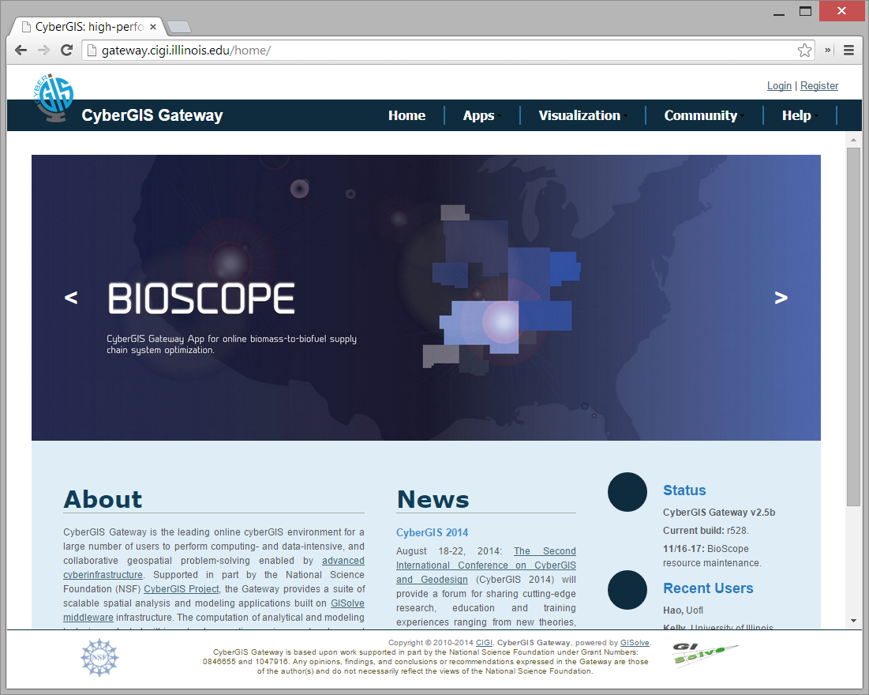
CyberGIS Gateway
gateway.cybergis.org | sandbox.cybergis.org
Notes:
Gateway and Sandbox

Slide 11
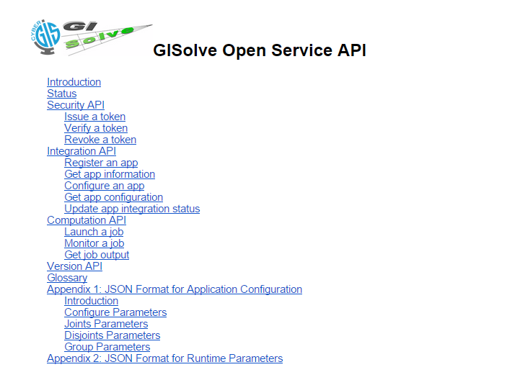
GISolve Middleware
www.cigi.illinois.edu/dokuwiki/doku.php/projects/gisolve/index
Notes:
The API is documented at the link below.

Slide 12
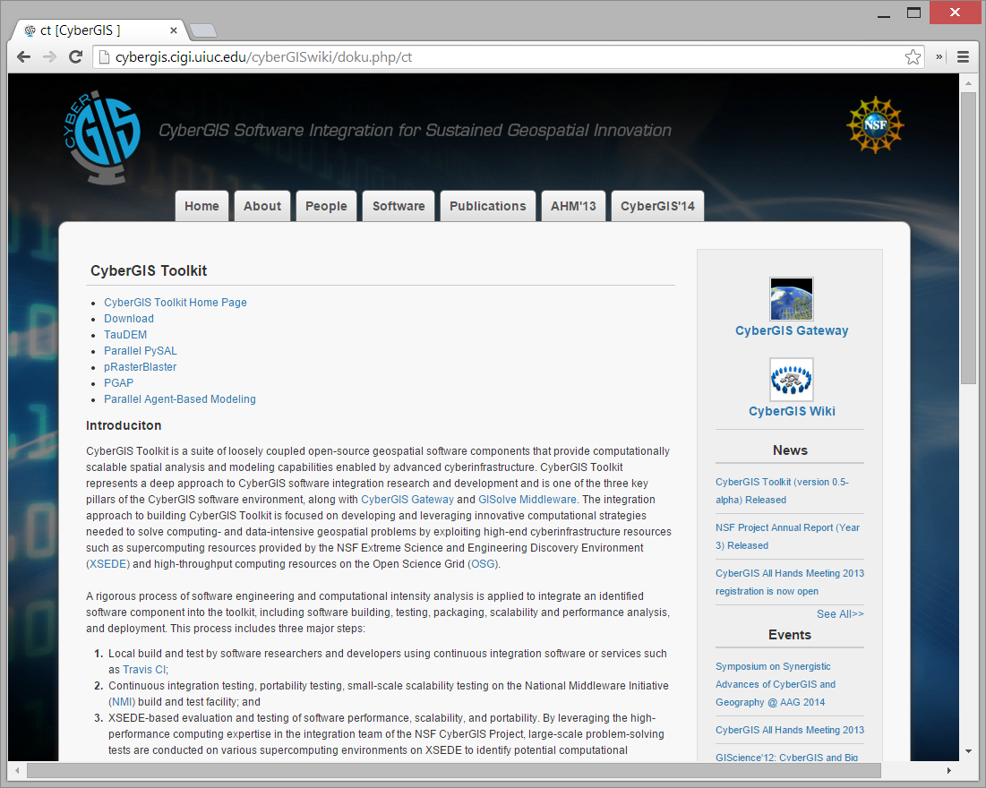
CyberGIS Toolkit
cybergis.cigi.uiuc.edu/cyberGISwiki/doku.php/ct
Notes:
These tools are open source and you can download them.

Slide 13
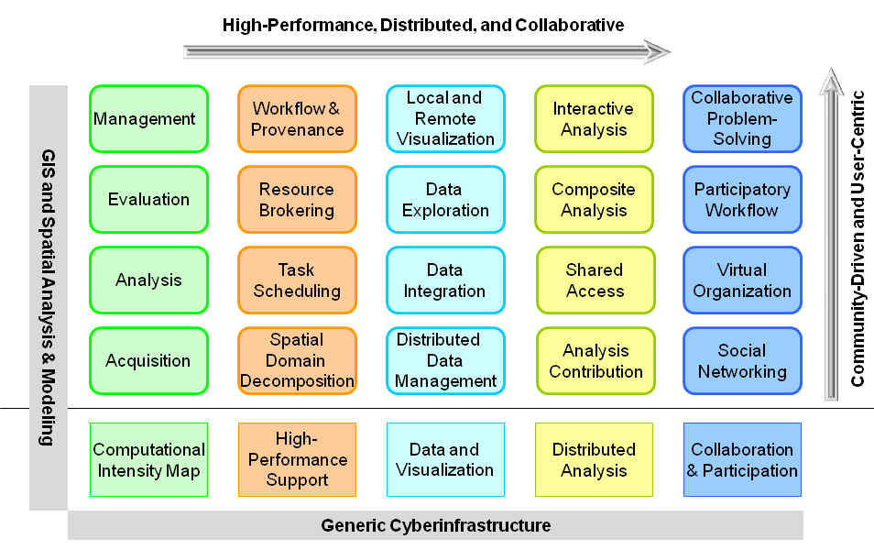
CyberGIS Toolkit
CyberGIS architecture
(source: Wang et al., 2013)
Notes:
These tools are open source and you can download them.

Slide 14
Terminologies
Cloud computing
High performance computing
High-throughput computing
Distributed computing
Hadoop and Spark
Non-relational database (NoSQL)
Distributed database
Parallel computing
Computational geography
WebGIS
Notes:
Suggest to read more on these terms and understand the commons and differences among them

Slide 15
CyberGIS Center for Advanced Digital and Spatial Studies
Empower advanced digital and spatial studies through innovation of
CyberGIS technologies and applications
Notes:
Mission of center

Slide 16
Agriculture and Food Disaster and Emergency Earth and Environment Energy and Water Resources Health and Wellness
Research Application Focus Areas:

Slide 17
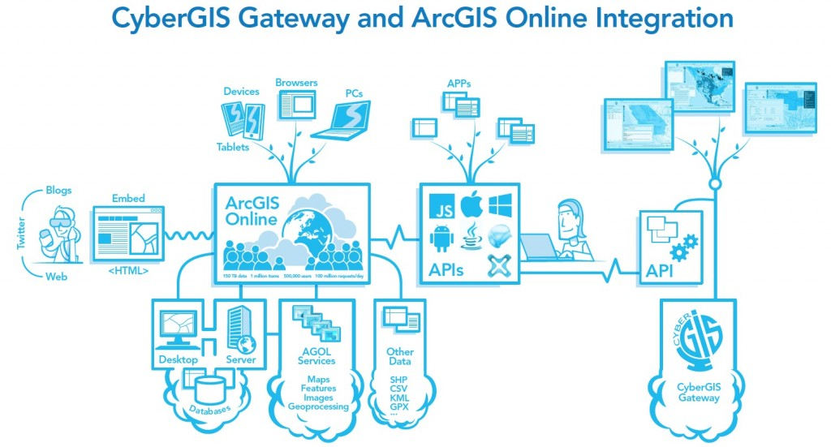
Image source: http://blogs.esri.com/esri/arcgis/2013/10/01/what-is-cybergis/
Notes:
Beyond our software stack (toolkit/middleware/gateway) we are working on integration with other GIS workflows, like ArcGIS online. The campus has a license for ArcGIS online, so in the future, our users will be able to benefit from this tighter integration (like chosing where to process a model, or sending data layers between the Gateway and ArcGIS Online). For more info on ArcGIS Online at UIUC, contact James Whitacre at Scholarly Commons.

Slide 18
Notes:
A quick breakdown of what features come from which research fields. CyberGIS connects spatial domain sciences to advanced CI.

Slide 19
Education, Outreach, and Training Activities
CyberGIS Commons
For hands-on learning and training
CyberGIS Collaboration Space
For groups to develop collaborative research
CyberGIS Helpdesk
For in-depth technical consulting
CyberGIS Brown Bag Seminars
Once every two to three weeks on average
CyberGIS Distinguished Speaker Series
Once every two months on average
CyberGIS MOOCs
CyberGIS Webinars

Slide 20
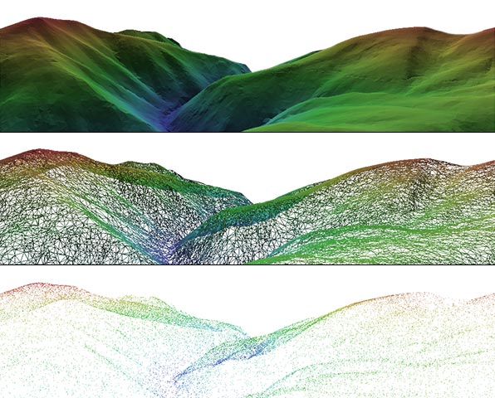
Geospatial Big Data
Volume
USGS NED 30m(175GB), 10m(500GB)
Variety
Forms and formats (Raster and Vector)
Shapefile, GeoTiff, GeoJSON, WMS, WFS,
NetCDF, HDF5
Velocity
All Geocoded Tweets
2.5kb/tweet
6,000 average tweet per second
3% of tweets are geo-located
38GB per day
Landsat 8
650GB per day
Veracity
Uncertainty
Notes:
we are living in a world of unprecedented data volume, variety, and velocity
This is why Hadoop comes in.

Slide 21
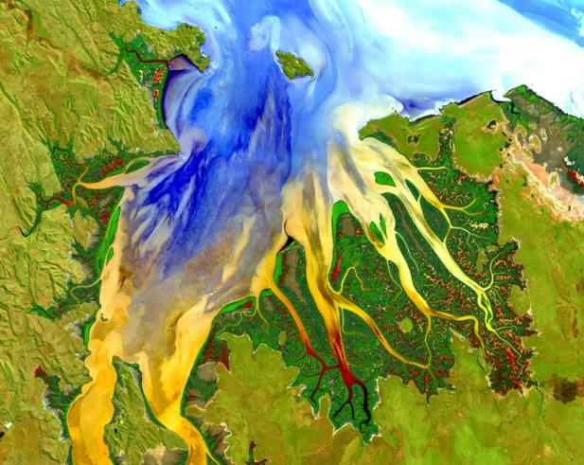

Geospatial Big Data
Landsat 8
~650 images per day
~1GB each (compressed)
~650gb per day
Twitter Firehose
All Geocoded Tweets
~2.5KB / tweet
~6,000 average tweet per second
~3% of tweets are geolocated
~38GB per day
Notes:
Animations on slide, don’t mind the overlapping.

Slide 22
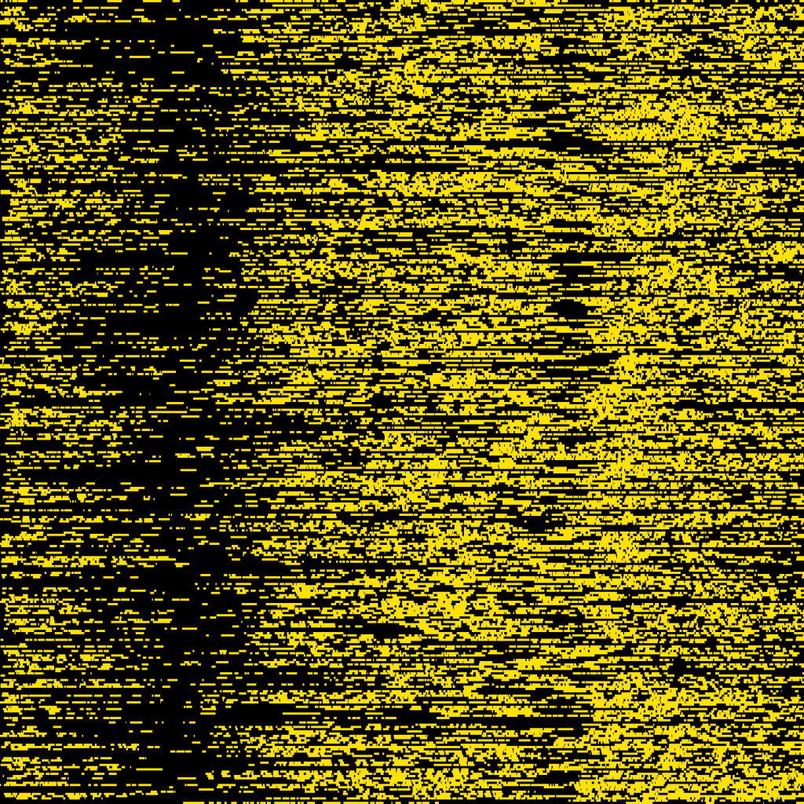
Geospatial Big Data
Visualization of New York taxi data
The black pixel means the taxi did not have fare and yellows means it did
Source: http://chriswhong.com/open-data/my-first-data-art-nyc-taxi-defrag/
Notes:
Each row represents one taxi, each pixel is one minute and 60 minutes, 12 hours a day.

Slide 23
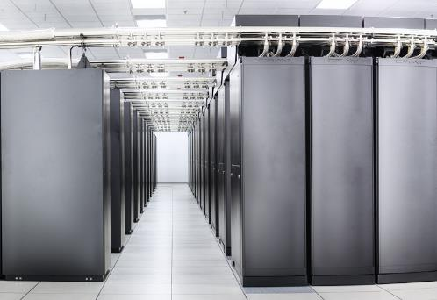
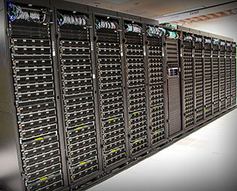
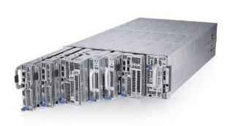
CyberInfrastructure Resources
NSF Blue Waters @ UofI
NSF XSEDE: SDSC Comet
UofI Campus Cluster
13,300 TFlop/s
2,000 TFlop/s
Notes:
Examples of the kind of computational/hardware resources that our group has made use of and can be targeted by the GISolve Open Service API / Middleware.

Slide 24
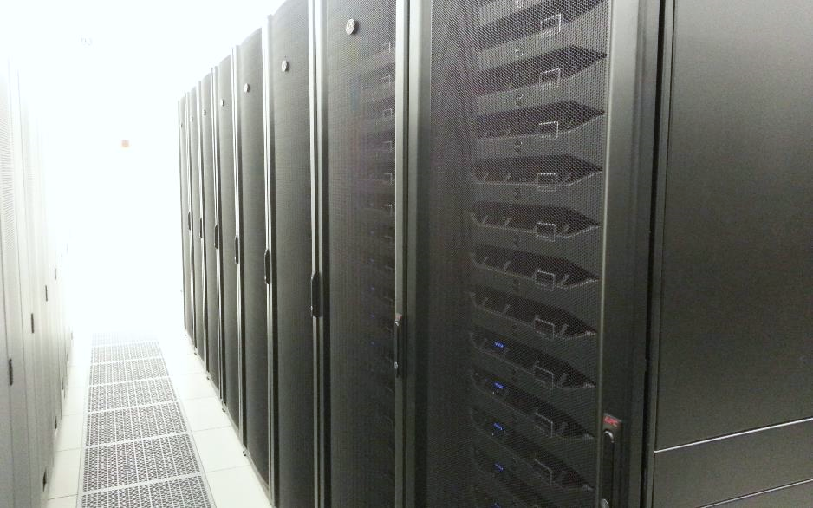
CyberGIS ROGER
CyberGIS ROGER
Resourcing Open Geospatial Education and Research
After Roger Tomlinson
goo.gl/8MpYC9
~60 TFlop/s
Notes:
Roger Tomlinson has been called the “Father of GIS” thanks to his leadership of the Canada Geographic Information System, the first computerized GIS.
The Tflops number for ROGER is theoretical, it has not been benchmarked yet. It is undergoing testing now, and should be fully open for use before fall semester. For more information, contact Johnathan (jfr@Illinois)

Slide 25
Why ROGER?
Both a research project and a research resource
Configured to best support geospatial data, with emphases on local memory and shared storage size and speed
Supports multiple paradigms: traditional batch HPC, Hadoop, and Cloud (OpenStack).
Integrate the three paradigms and leverage their strengths
Inform the design of future geospatial supercomputers

Slide 26
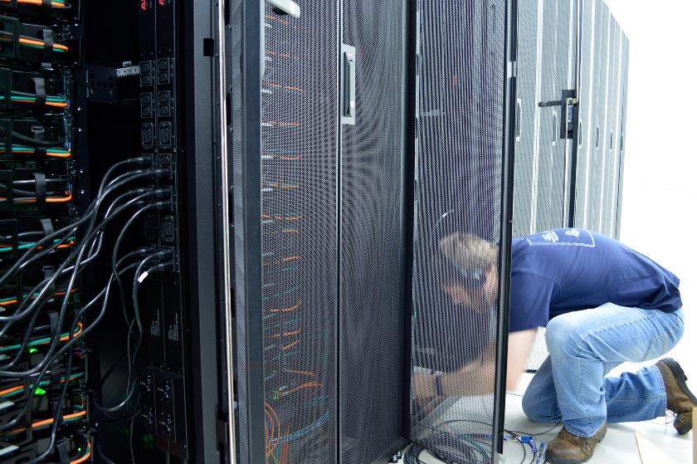
ROGER: Overview
Provides the CyberGIS Center with HPC, Hadoop and OpenStack functionality all on one system
Managed by Systems Group
With support from our storage, network, security and services groups

Slide 27
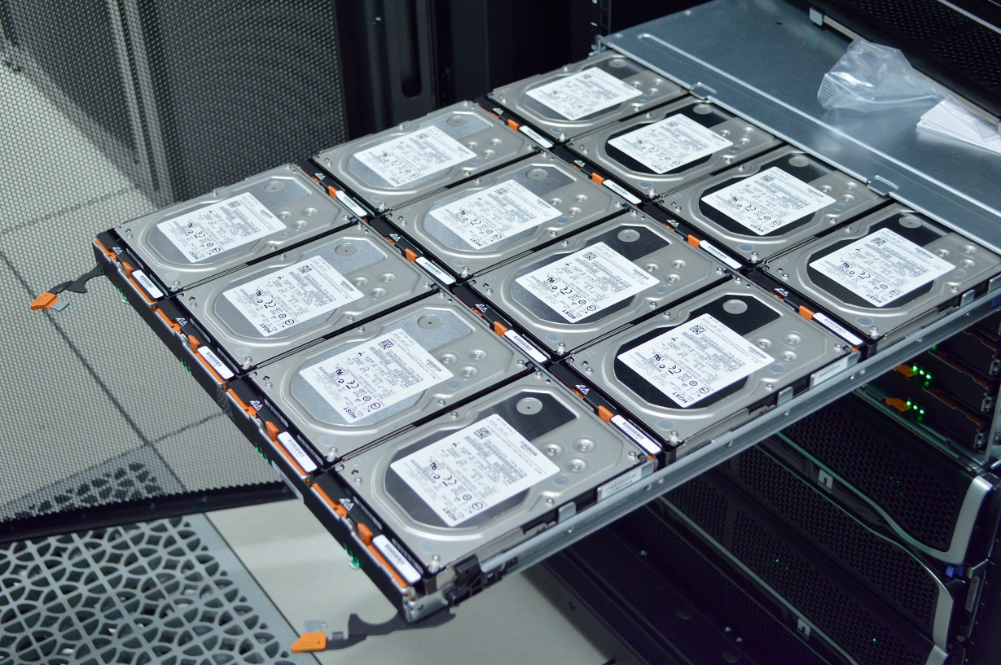
ROGER: File system
IBM General Parallel File System (GPFS)
Parallel file system means all of the nodes get fast access to hard drive storage.

Slide 28
ROGER for this class
Will create ROGER accounts for every student in this class
Interact with various components in ROGER
Job submission
Handling and processing massive data with Hadoop, Spark, R, and Python, etc.
Getting to know OpenStack
Working with Geospatial libraries

Slide 29




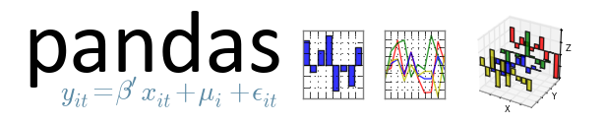

ROGER for this class

Slide 30
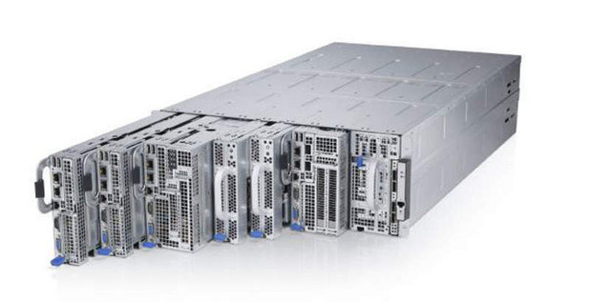
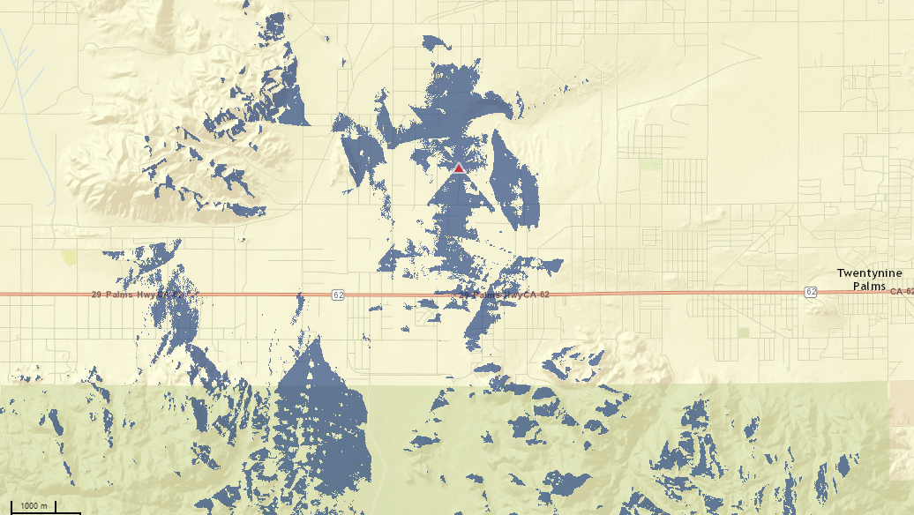
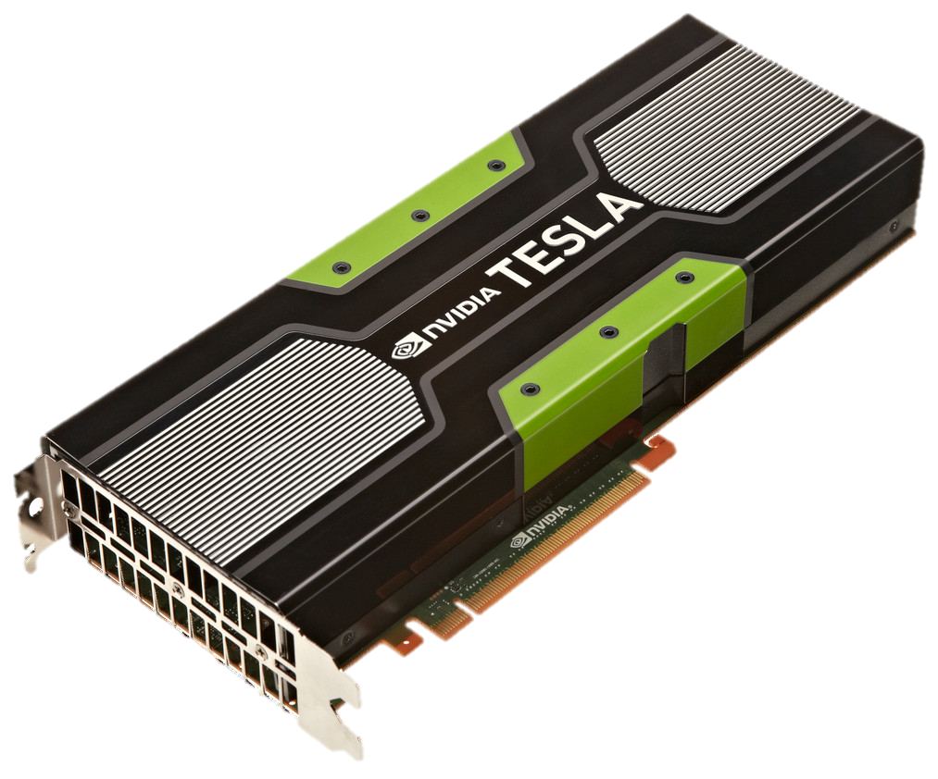
CyberGIS Viewshed App
UofI Cluster
Viewshed
Notes:
Describe what a Viewshed is. A GPU is a natural fit for this kind of operation, since they were initially designed for video games that need to do these visibility calculations many times a second.

Slide 31
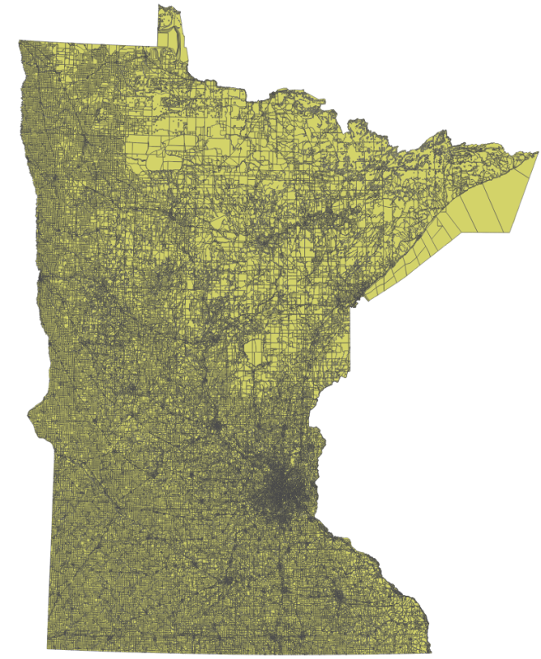
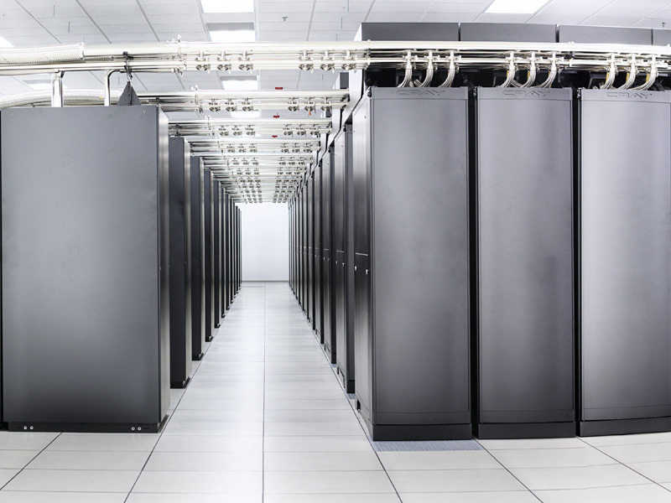
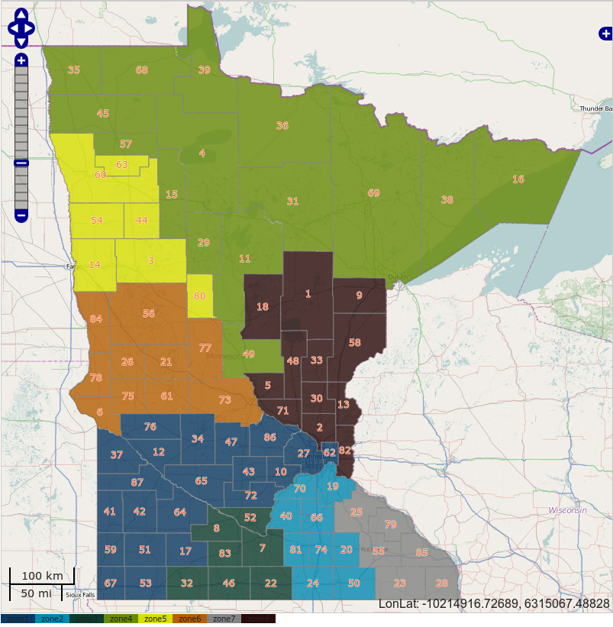
Parallel Genetic Algorithm for Redistricting Optimization on Blue Waters
NSF Blue Waters @ UofI
13,300 TFlop/s
Collaborative Work with Wendy K. Tam Cho @ UIUC
Notes:
Parallel GA – Blue Waters
Uses genetic algorithm to try to find optimum arrangement of census blocks into voting districts. Very computationally intensive so we run it on Blue Waters. Parallel GA is needed as an approximation of an optimum solution, since running every combination of units is intractable.
More background on intractability of finding perfect solution: the maximum number of computations is a factorial expansion, or “a Stirling Number of the Second Kind.” 100 voting districts into 8 combinations would be 5*10^85. There are 4104 voting districts in Minnesota. Don’t need to go into this detail, though.

Slide 32
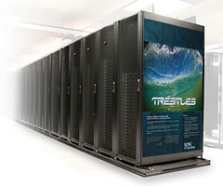
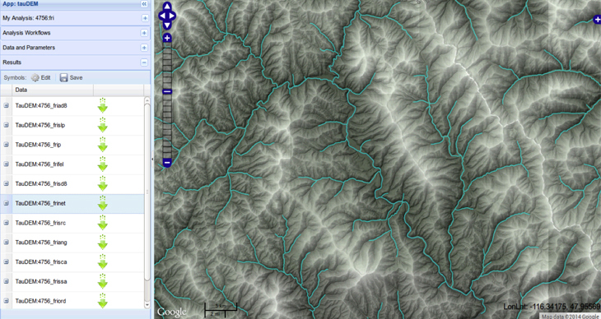
CyberGIS TauDEM App
TauDEM
NSF XSEDE: SDSC Trestles
100 TFlop/s
Collaborative Work with David Tarboton @ Utah State University
Notes:
Describe that TauDEM enables many kinds of hydrologic calculations based on elevation datasets. Right now, we’re running it on Trestles.

Slide 33
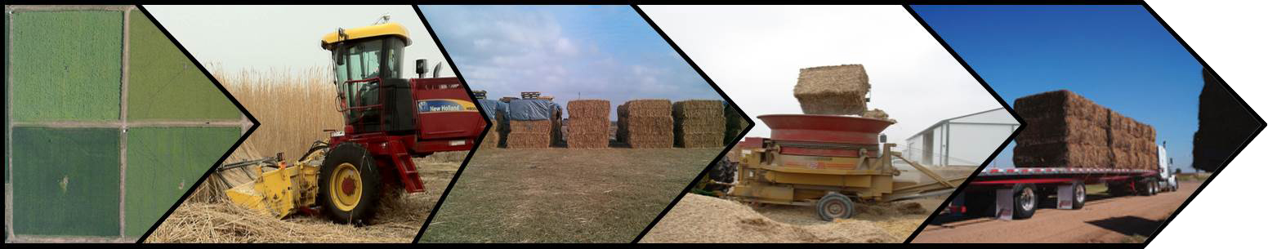
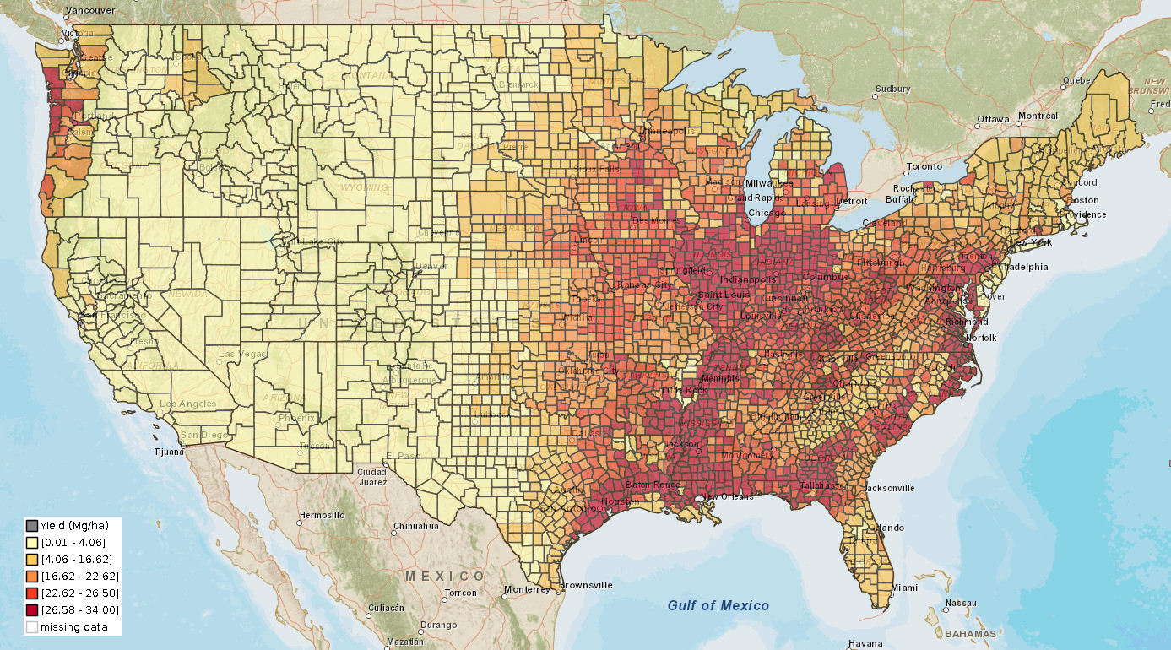
CyberGIS BioScope App
Notes:
Miscanthus Yield. Miscanthus is a tall grass that can grow over three meters in a season.
- Biomass supply chain optimization (BioScope) aims to facilitate large-scale biofuel production by improving biomass provision efficiency and effectiveness.
- The BioScope model optimizes a three-stage biomass provision system that includes farms, centralized storage and preprocessing (CSP) facilities, and biorefineries.
- The model can minimize biomass provision costs by optimizing the numbers, locations, and capacities of facilities and biomass transportation patterns.

Slide 34
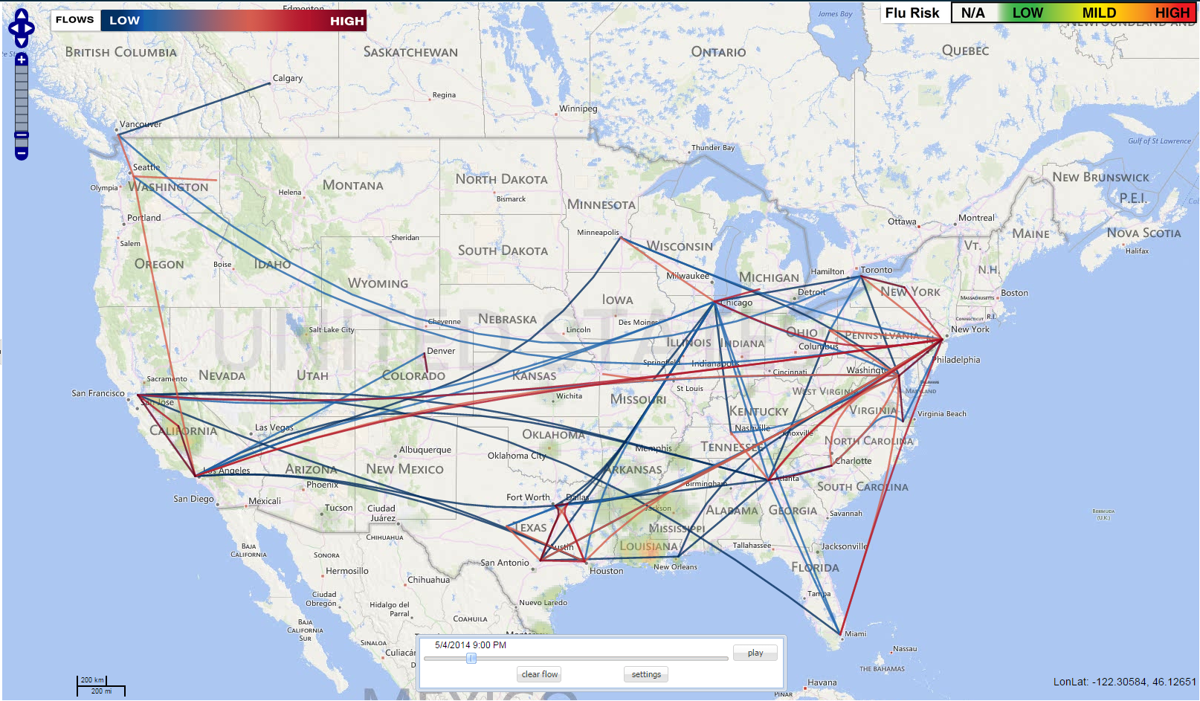
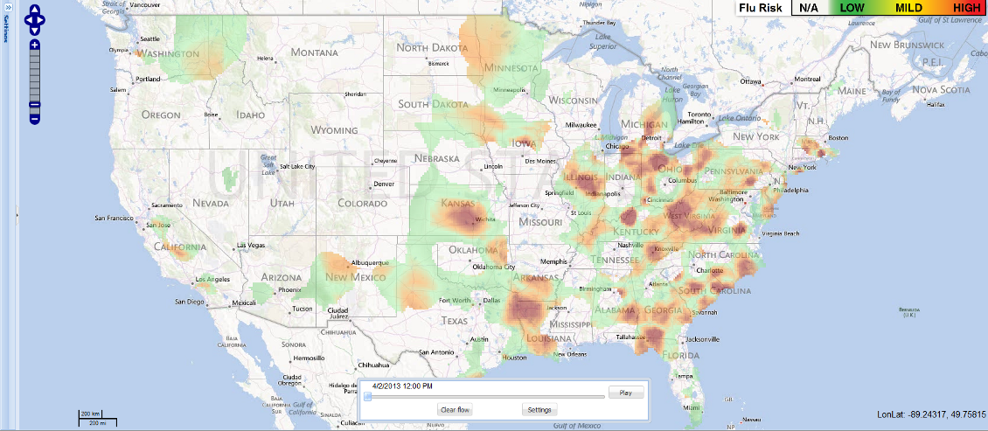
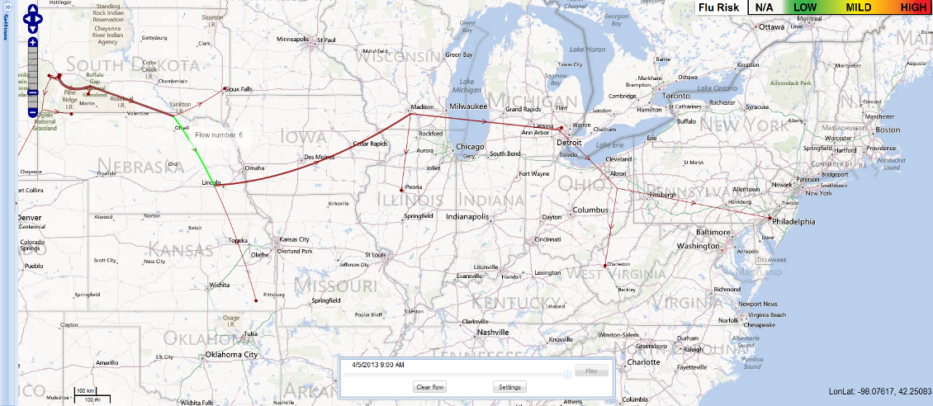
CyberGIS FluMapper App

Slide 35
Lab
FluMapper
Social media, point data, streaming data, Hadoop, routing, raster and vector visualization
BioScope
Agriculture, supply chain optimization, chart generation, reference base maps
TauDEM
Hydrologic data analysis, digital elevation models, code reuse
Notes:
create their accounts now if they haven’t already.
TauDEM only if we have time available, but you have those materials in your handouts and on the link provided in the cover page. Please fill out an evaluation form in your folders before you leave.
Note that TauDEM takes awhile to run because there are many jobs in the queue. If you want to see some TauDEM results, you can use the example results account on the cover page. Do submit your own job on your own account first, though, so you understand what you’re looking at.

Slide 36
Reference
Wang, S., Anselin, L., Bhaduri, B., Crosby, C., Goodchild, M. F., Liu, Y., and Nyerges, T. L. (2013). Cybergis software: a synthetic review and integration roadmap. International Journal of Geographical Information Science, 27(11), 2122–2145.
Wang, S. (2013) “CyberGIS: Blueprint for Integrated and Scalable Geospatial Software Ecosystems.” International Journal of Geographical Information Science, 27 (11): 2119-2121
Notes:
create their accounts now if they haven’t already.
TauDEM only if we have time available, but you have those materials in your handouts and on the link provided in the cover page. Please fill out an evaluation form in your folders before you leave.
Note that TauDEM takes awhile to run because there are many jobs in the queue. If you want to see some TauDEM results, you can use the example results account on the cover page. Do submit your own job on your own account first, though, so you understand what you’re looking at.

